Slide 1
Testing of Hypothesis

Slide 2
Hypothesis Testing
A statistical hypothesis is an assertion or conjecture concerning one or more populations.

Slide 3
The Null and Alternative Hypotheses
Null hypothesis, which refers to any hypothesis we wish to test and is denoted by H0.
The rejection of H0 leads to the acceptance of an alternative hypothesis, denoted by H1.

Slide 4
Test Statistic
The rule or formula.

Slide 5
Approach to Hypothesis Testing with Fixed Probability
State the null and alternative hypotheses.
Choose a fixed significance level α.
Establish critical region based on α.
Choose an appropriate test statistic.
Perform computation.
Reject H0 if the computed test statistic is in the critical region. Otherwise, do not reject.

Slide 6
Significance Testing (P-Value Approach)
State null and alternative hypotheses.
Choose an appropriate test statistic.
Perform computation.
Compute the P-value based on the computed value of the test statistic.
Use judgment based on the P-value and knowledge of the scientific system.

Slide 7
p value
The p value is a number, calculated from a statistical test, that describes how likely you are to have found a particular set of observations if the null hypothesis were true.
P values are used in hypothesis testing to help decide whether to reject the null hypothesis. The smaller the p value, the more likely you are to reject the null hypothesis.

Slide 8
p value
If the p-value of the hypothesis test is less than some significance level (e.g. α = .05), then we can reject the null hypothesis and conclude that we have sufficient evidence to say that the alternative hypothesis is true.
If the p-value is not less than .05, then we fail to reject the null hypothesis and conclude that we do not have sufficient evidence to say that the alternative hypothesis is true.

Slide 9
Single Sample: Tests Concerning a Single Mean

Slide 10
Tests on a Single Mean (Variance Known)

Slide 11
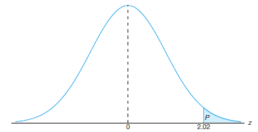
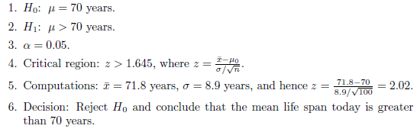
Example: A random sample of 100 recorded deaths in the United States during the past year showed an average life span of 71.8 years. Assuming a population standard deviation of 8.9 years, does this seem to indicate that the mean life span today is greater than 70 years? Use a 0.05 level of significance.
Solution:
The P-value corresponding to z = 2.02 is given by the area of the shaded region in Figure , using Table A.3, we have
P = P(Z > 2.02) = 1-0.9783 =0.0217.
As a result, the evidence in favor of H1 is even stronger than that suggested by a 0.05 level of significance.

Slide 12
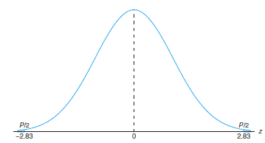
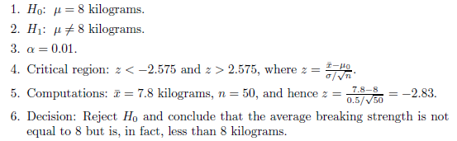
Example: A manufacturer of sports equipment has developed a new synthetic fishing line that the company claims has a mean breaking strength of 8 kilograms with a standard deviation of 0.5 kilogram. Test the hypothesis that μ = 8 kilograms against the alternative that μ ≠ 8 kilograms if a random sample of 50 lines is tested and found to have a mean breaking strength of 7.8 kilograms. Use a 0.01 level of significance.
Solution:
P = P(|Z| > 2.83) = 2P(Z < −2.83) = 0.0046,
which allows us to reject the null hypothesis that μ = 8 kilograms at a level of significance smaller than 0.01.

Slide 13
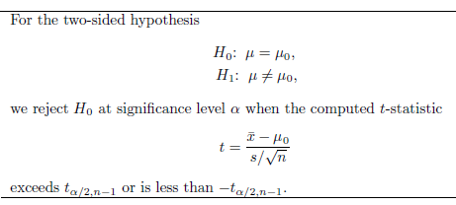
The t-Statistic for a Test on a Single Mean (Variance Unknown)
For H1: μ > μ0, rejection results when t > tα,n−1. For H1: μ < μ0, the critical region is given by t < −tα,n−1.

Slide 14
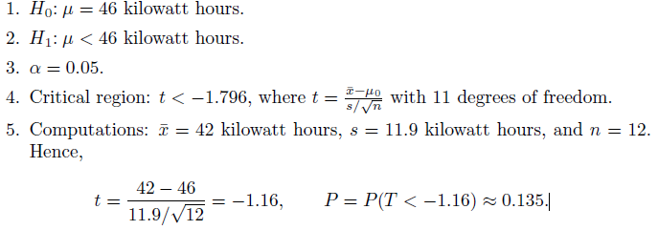

Example: The Edison Electric Institute has published figures on the number of kilowatt hours used annually by various home appliances. It is claimed that a vacuum cleaner uses an average of 46 kilowatt hours per year. If a random sample of 12 homes included in a planned study indicates that vacuum cleaners use an average of 42 kilowatt hours per year with a standard deviation of 11.9 kilowatt hours, does this suggest at the 0.05 level of significance that vacuum cleaners use, on average, less than 46 kilowatt hours annually? Assume the population of kilowatt hours to be normal.
Solution:

Slide 15
Assignment
10.19
10.20
10.21
10.22
10.24
10.25
10.26

